Slide 1
Assessing the robustness of meta-analytic results: Why sensitivity analyses matter
Sven Kepes George Banks
Michael A. McDaniel Traci Sitzmann

Slide 2
Overview
Meta-analytic findings are viewed as a primary means for generating cumulative knowledge and bridging the often lamented gap between research and practice (Briner & Rousseau, 2011).
However, there are concerns regarding the robustness of meta-analytic results (e.g., Fiedler, 2011).

Slide 3
Overview
Robustness
The degree to which the results and conclusions of a meta-analysis remain stable when conditions of the data or the analysis change (Greenhouse & Iyengar, 2009).
Potential causes
Outliers
Publication bias

Slide 4
Overview
APA’s MARS recommend sensitivity analyses for the examination of outliers and publication bias.

Slide 5
Purpose
An evaluation of the potential influence of outliers and publication bias on meta-analytic results.
We give particular attention to the possibility of combined outlier and publication bias effects.

Slide 6
Sensitivity analyses
Outlier detection analyses
Less than 3% of the meta-analyses in the organizational sciences document the empirical assessment of outliers from the meta-analytic distribution (Aguinis et al., 2011).

Slide 7
Sensitivity analyses
Outlier detection analyses
Specific sample removed analysis.
E.g., with SAMD (Beal, Corey, & Dunlap, 2002; Huffcutt & Arthur, 1995).
One-sample removed analysis (Borenstein et al., 2009).
Random- and fixed-effects estimates (Greenhouse & Iyengar, 2009).

Slide 8
Sensitivity analyses
Publication bias analyses
Most meta-analytic reviews in the organizational sciences do not document the empirical assessment of publication bias, with estimations ranging from 2% (Aguinis et al., 2011) to 18% (Aytug et al., 2012) and 31% (Banks et al., 2012).

Slide 9
Sensitivity analyses
Publication bias analyses
Contour-enhanced funnel plot (e.g., Peters et al., 2008).
Trim and fill (e.g., Duval, 2005).
Egger’s test of the intercept (e.g., Egger et al., 1997).
Selection models (e.g., Vevea & Woods, 2005).
Cumulative meta-analysis (e.g., Kepes et al., in press).

Slide 10
Current study
Sensitivity analyses on data from a prior meta-analytic review concerning the antecedents and outcomes of trainee reactions (Sitzmann et al., 2008).
14 trainee reactions sub-group distributions.

Slide 11
Analysis approach
Comprehensive Meta-Analysis
Meta-analysis, one-sample removed analysis, fixed- vs. random effects, trim and fill, Egger’s test of the intercept, cumulative meta-analysis.
Stata
Contour-enhanced funnel plots.
R software
Selection models.

Slide 12
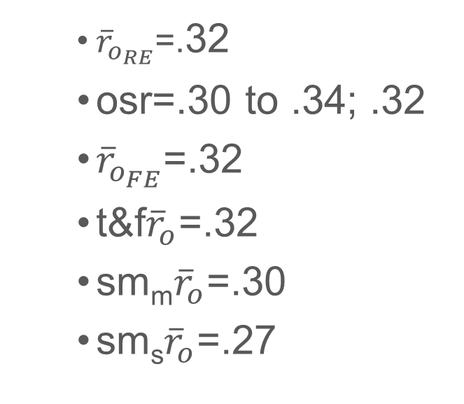
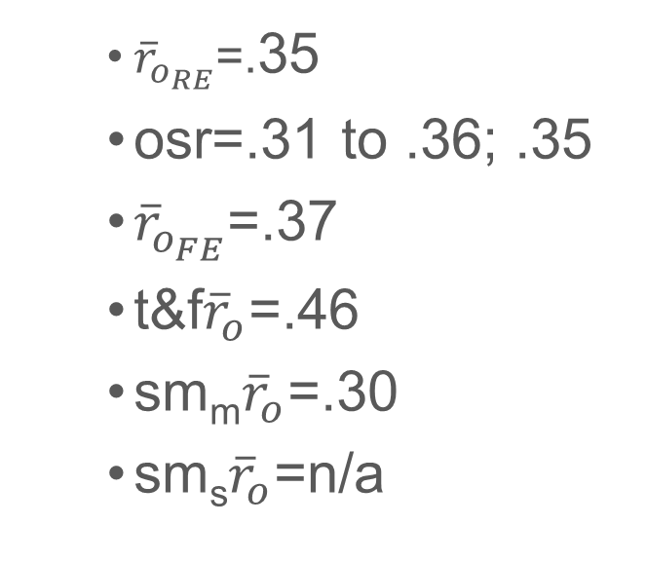
Results
Example: Pre-training motivation (k=22) before/after the removal of two outliers
${\overline{r}}_{o_{RE}}$=.35
osr=.31 to .36; .35
${\overline{r}}_{o_{FE}}$=.37
t&f${\overline{r}}_{o}$=.46
sm_{m}${\overline{r}}_{o}$=.30
sm_{s}${\overline{r}}_{o}$=n/a
${\overline{r}}_{o_{RE}}$=.32
osr=.30 to .34; .32
${\overline{r}}_{o_{FE}}$=.32
t&f${\overline{r}}_{o}$=.32
sm_{m}${\overline{r}}_{o}$=.30
sm_{s}${\overline{r}}_{o}$=.27

Slide 13
Results
Contour-enhanced funnel plots (example)
Pre-training motivation before and after the removal of two outliers

Slide 14
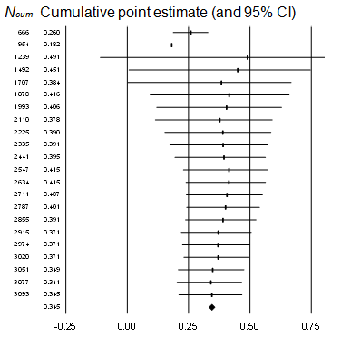
Results
Cumulative meta-analysis (example)
Pre-training motivation before and after the removal of two outliers

Slide 15
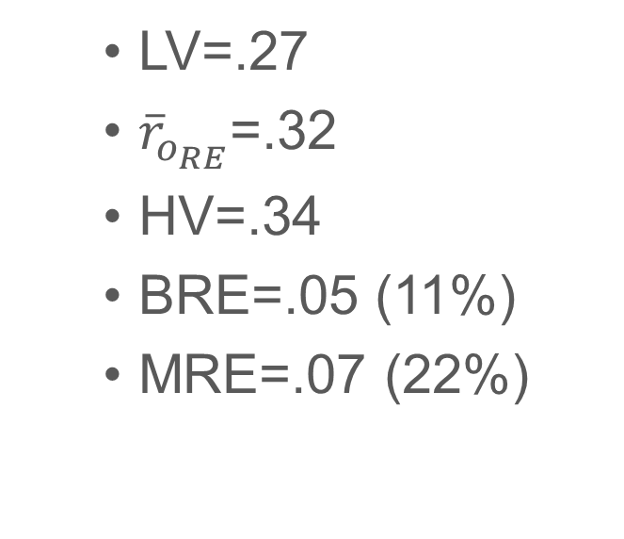
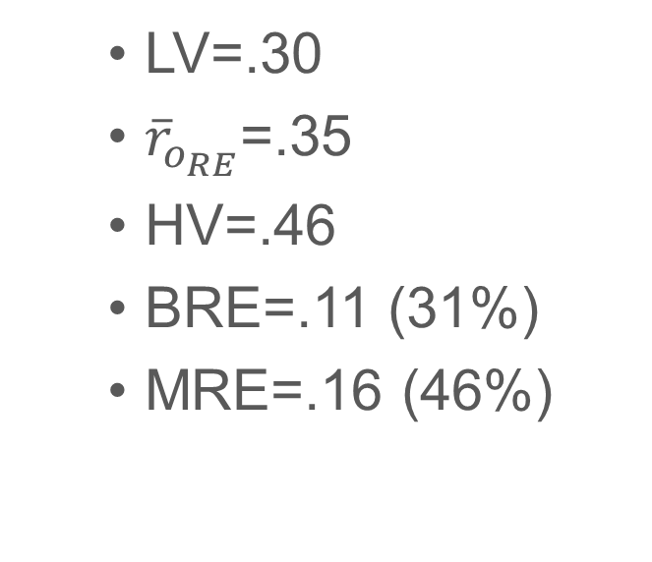
Results
Robustness: Pre-training motivation before/after the removal of two outliers
LV=.30
${\overline{r}}_{o_{RE}}$=.35
HV=.46
BRE=.11 (31%)
MRE=.16 (46%)
LV=.27
${\overline{r}}_{o_{RE}}$=.32
HV=.34
BRE=.05 (11%)
MRE=.07 (22%)

Slide 16
Conclusion
Results from several distributions were affected by outliers and/or publication bias.
The RE mean estimates of some distributions are not robust; they could be under- or overestimates.
It is possible that results from other meta-analytic reviews are also non-robust.

Slide 17
Conclusion
Recommendations
Comprehensive sensitivity analyses in all meta-analytic reviews.
There is a possibility that outliers and publication bias have a substantial effect on some meta-analytic findings.
Presentation of a range of parameter estimates rather than a single point estimate (i.e., triangulation; Orlitzky, 2012).

Slide 18
Conclusion
Limitations
Only one dataset analyzed.
But our results are consistent with previous studies (e.g., Banks et al., 2012; Huffcut & Arthur, 1995; Kepes et al., in press).

Slide 19
Questions

Slide 20
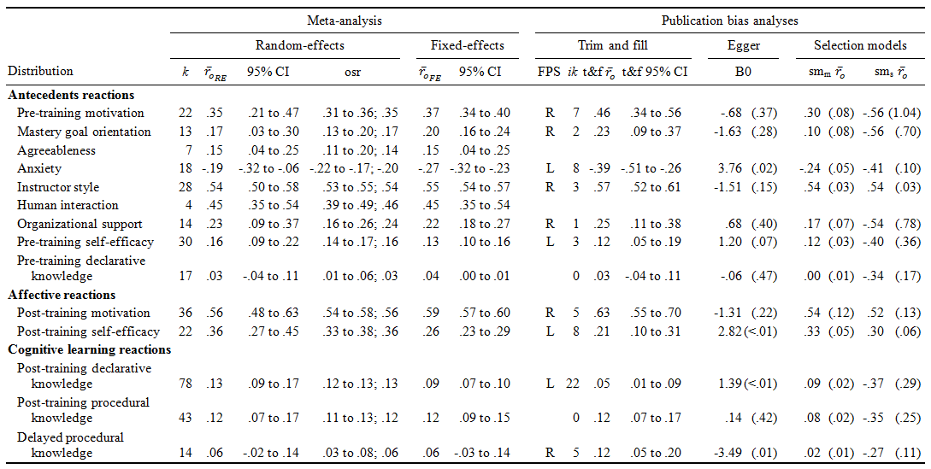
Results
Before the removal of outliers

Slide 21
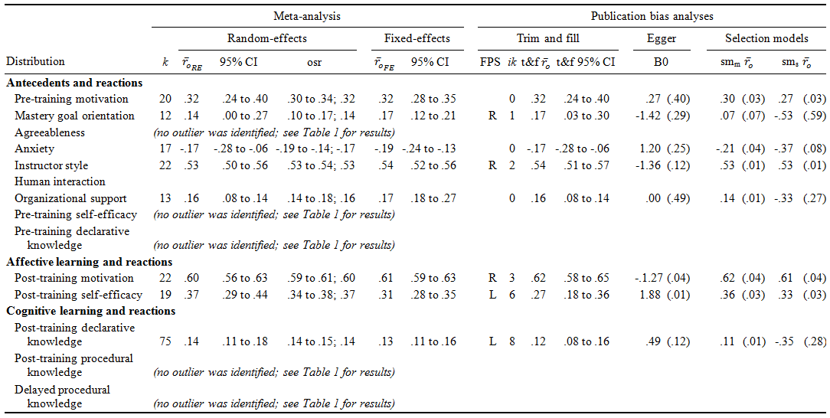
Results
After the removal of outliers

Slide 22
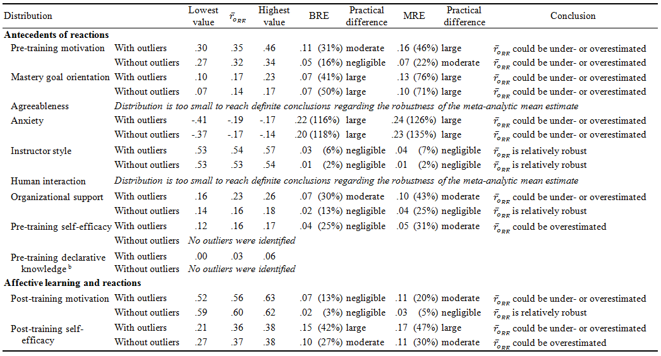
Results
Robustness of results

Slide 23
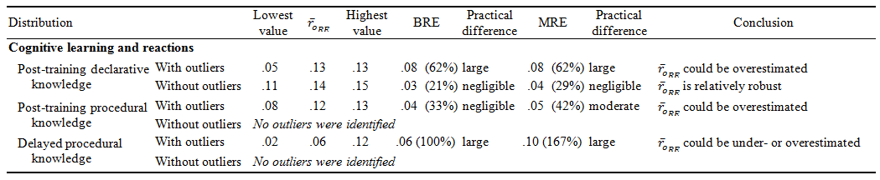
Results
Robustness of results

